Slide 1


Clustering methods
  Part 1: Introduction
Pasi Fränti
9th January, 2024

Slide 2

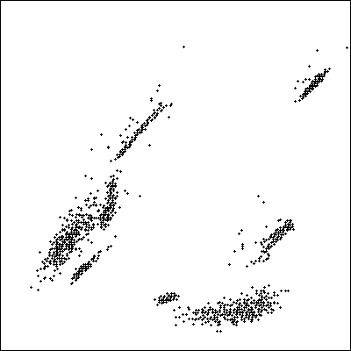
Sample data
Sources of RGB vectors
Red-Green plot of the vectors

Slide 3
Sample data
Employment statistics:

Slide 4
Application examples

Slide 5
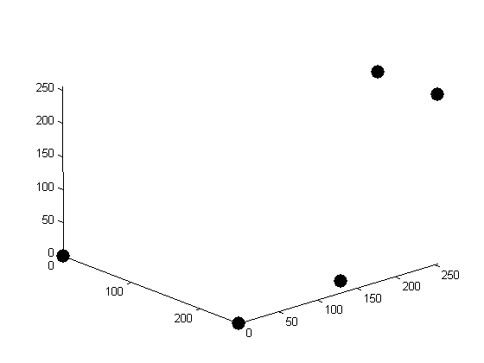
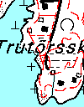
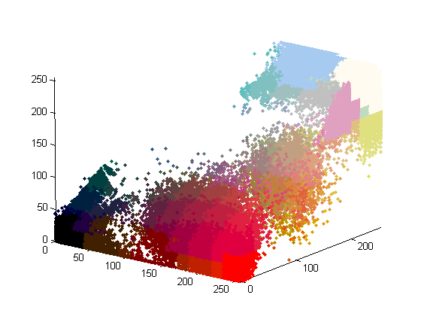

Color reconstruction
Image with original colors
Image with compression artifacts

Slide 6
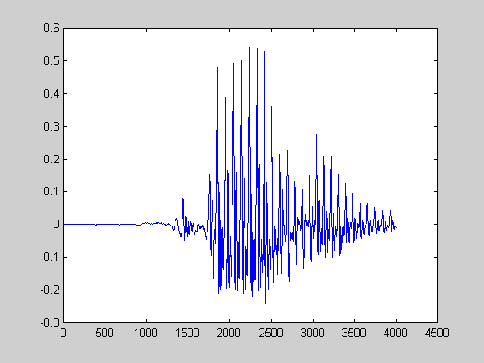
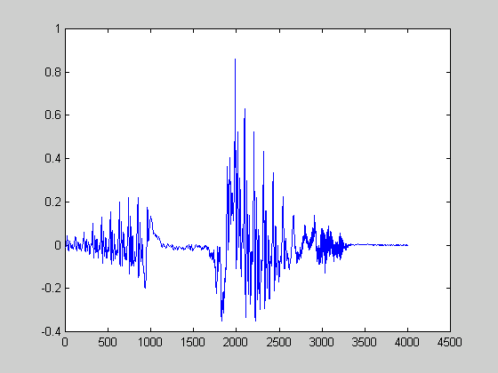
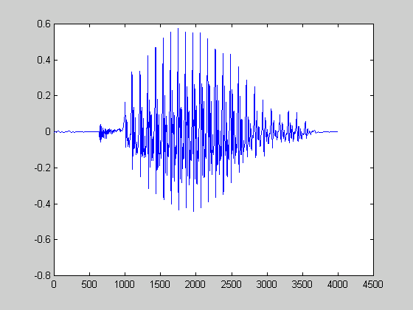
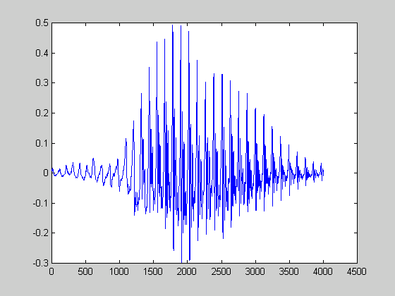
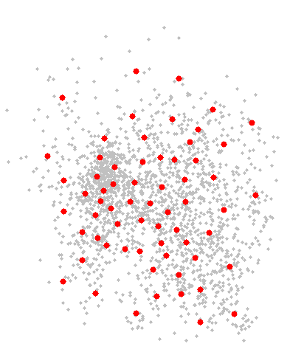
Speaker modeling for voice biometrics
Tomi
Feature extraction
and clustering
Mikko
Tomi
Matti
Training data
Matti
Feature extraction
Mikko
Speaker models
?
Best match: Matti !

Slide 7
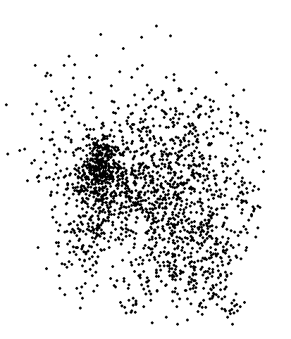
Speaker modeling
Speech data
Result of clustering

Slide 8

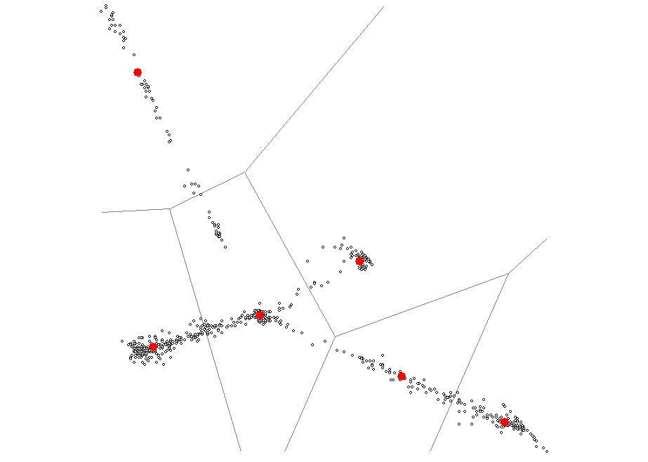
Image segmentation
Image with 4 color clusters
Normalized color plots according to red and green components.
green
red

Slide 9
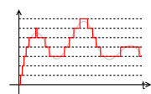
Signal quantization
Approximation of continuous range values (or a very large set of possible discrete values) by a small set of discrete symbols or integer values
Quantized signal
Original signal

Slide 10

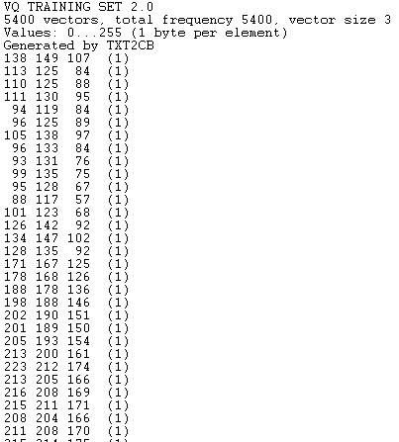
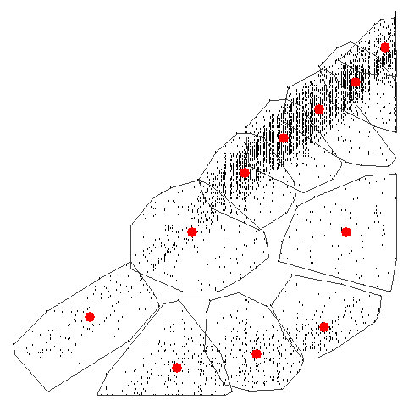
Color quantization of images
Color image
RGB samples
Clustering

Slide 11
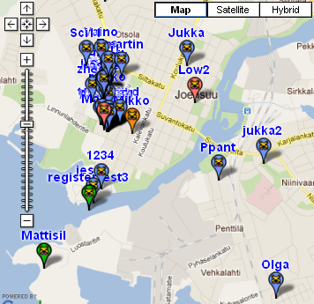
Users on map

Slide 12
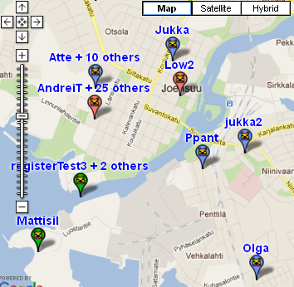
Clustering the users

Slide 13
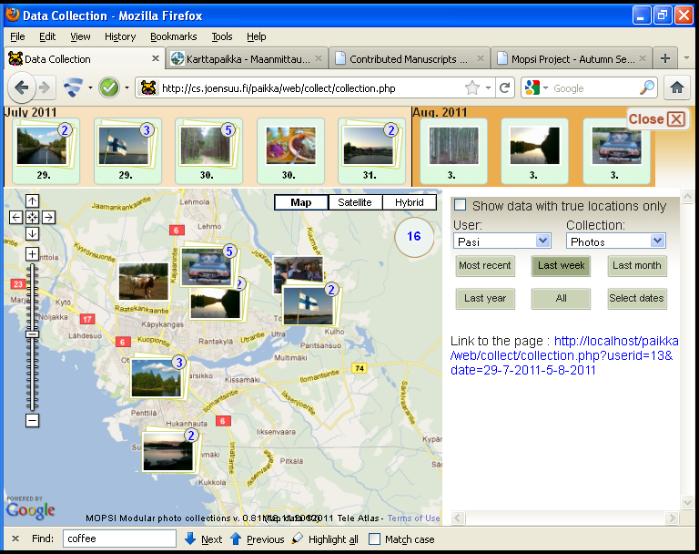
Clustering of photos in two ways
Clustering timeline
Clustering of photos

Slide 14
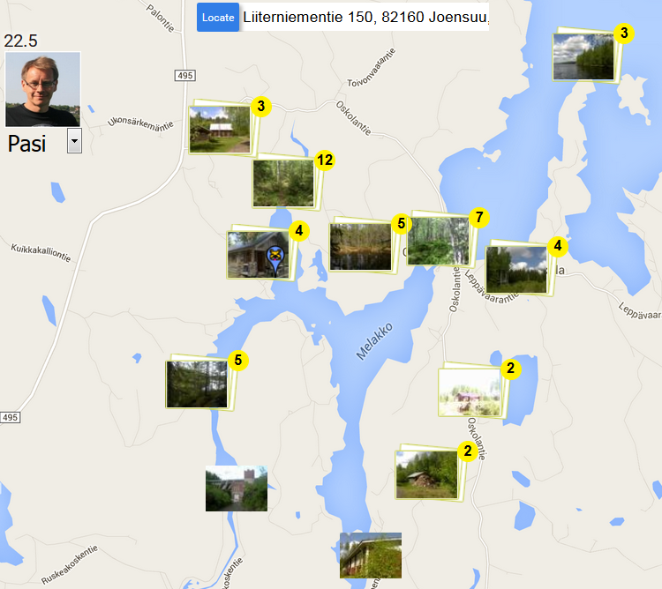
Photo clusters on map
User and
date
Last known location of the user
Number
of photos
Clusters

Slide 15
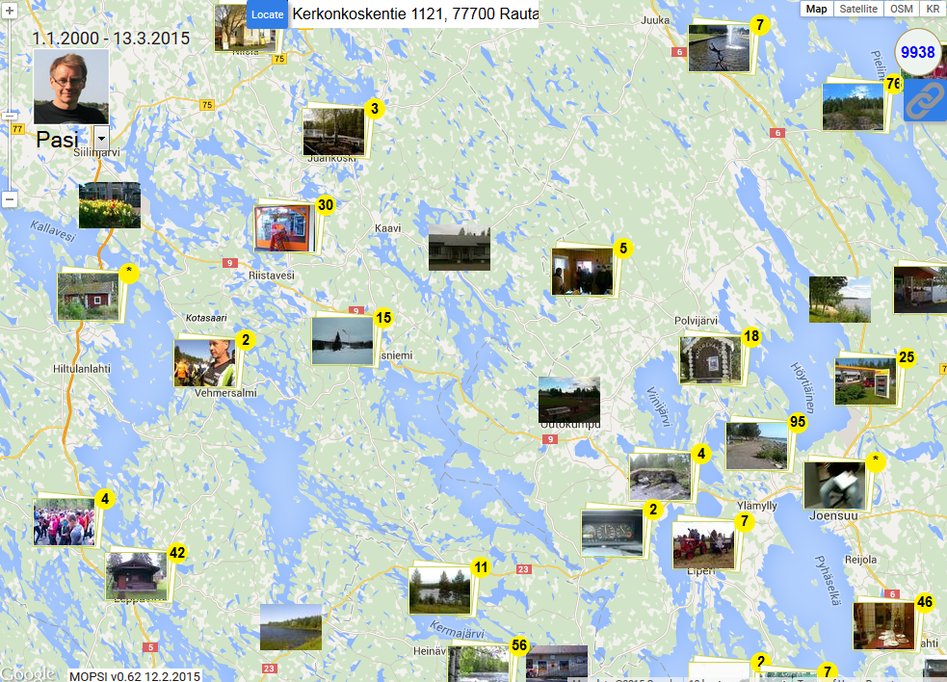

Slide 16

Clusters in the timeline view
Number
of photos
Clusters
Functions:
Open cluster
Start slideshow

Slide 17
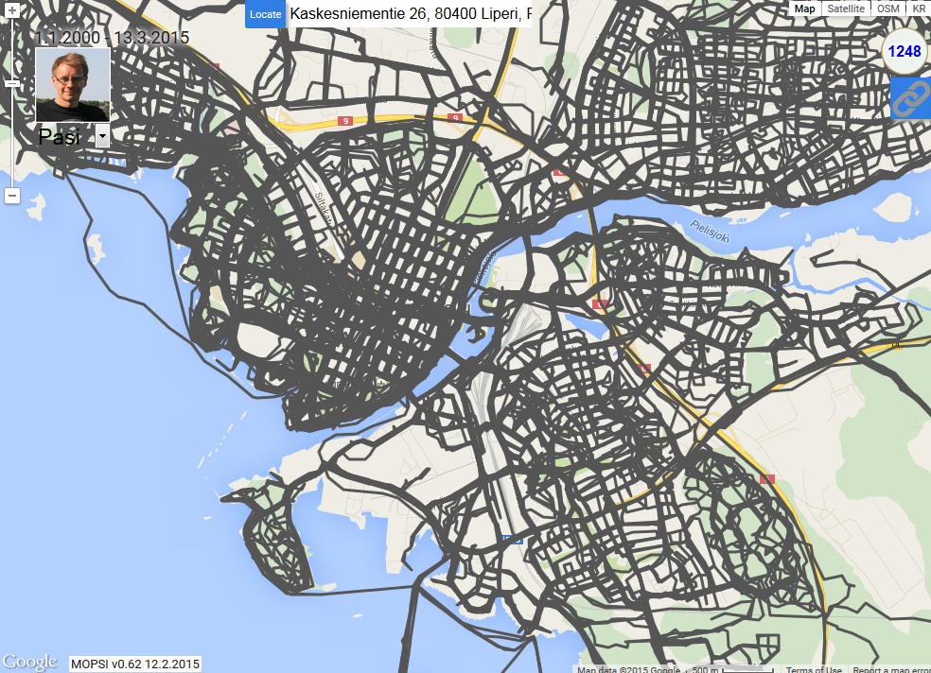
Clustering GPS tracks
Mobile users, taxi routes, fleet management

Slide 18
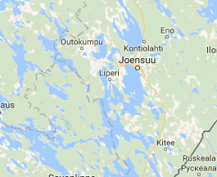
Optimizing cellular network
Model as clustering:
Weighted centroid
Stronger cells reach farther
Resource allocation problem
Algorithm:
K-means type algorithm
How to optimize weights?
Application requirements:
Population frequency
Coverage
Refine cost function

Slide 19
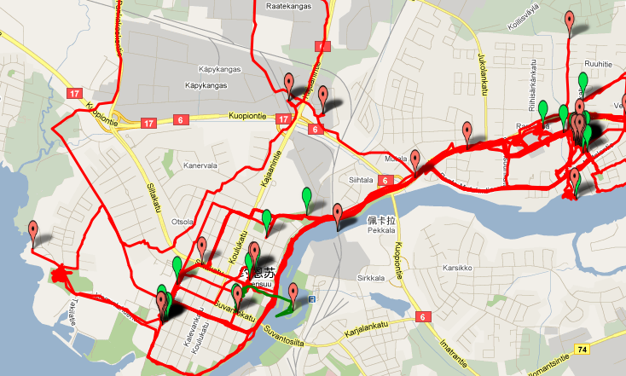
Conclusions from clusters
Cluster 2: Home
Cluster 1: Office

Slide 20
Clustering keywords
0.56
cafeteria
0.88
auberge
cafe
0.56
restaurant
coffeehouse
lodge
0
eatery
hostelry
cinema
0.91
0.88
hostel
film
movie
meal
bar
0.48
0.74
0.92
0.48
barroom
luncheon
stadium
saloon
0
lunch
0
ginmill
0.85
collation
arena
0
0.91
kiosk
0.91
snack
market
0.91
drugstore
gymnasium
pharmacy
0
outlet
cubicle
gym
shop
store
stall
booth

Slide 21
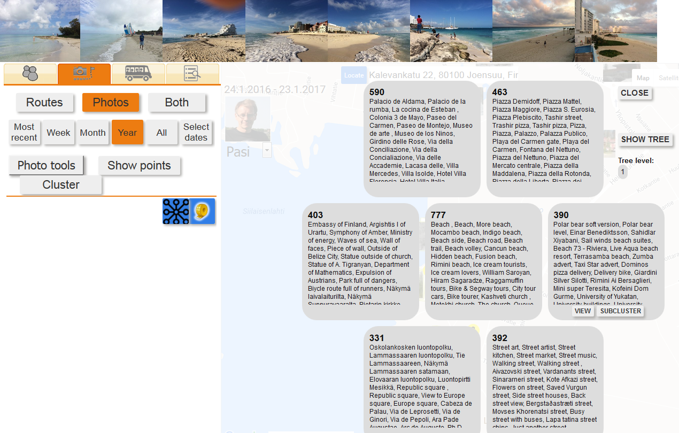
Clustering text descriptions

Slide 22
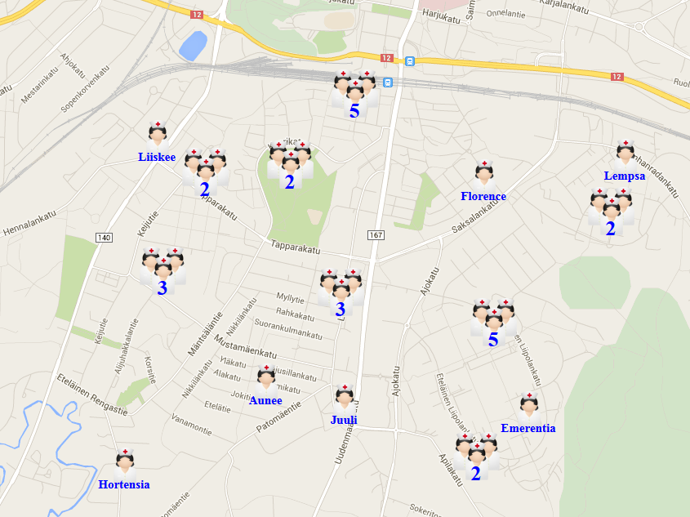
Home take care services

Slide 23
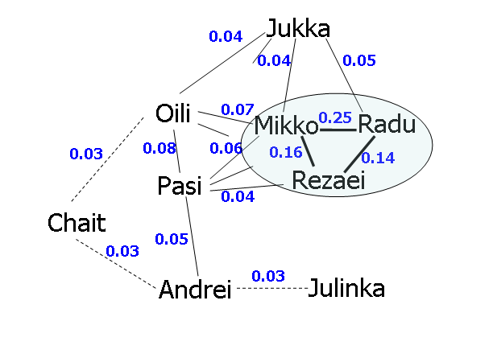
Clustering user preferences

Slide 24
Part I:
Clustering problem

Slide 25
Subproblems of clustering
Where are the clusters?
(Algorithmic problem)
How many clusters?
(Methodological problem: which criterion?)
Selection of attributes
(Application related problem)
Preprocessing the data
(Practical problems: normalization, outliers)

Slide 26




Definitions and data
Set of N data points:
X={x₁, x₂, …, x_{N}}
Partition of the data:
P={p₁, p₂, …, p_{M}},
Set of M cluster prototypes (centroids):
C={c₁, c₂, …, c_{M}},

Slide 27
Distance and cost function
Euclidean distance of data vectors:
Total square error:

Slide 28
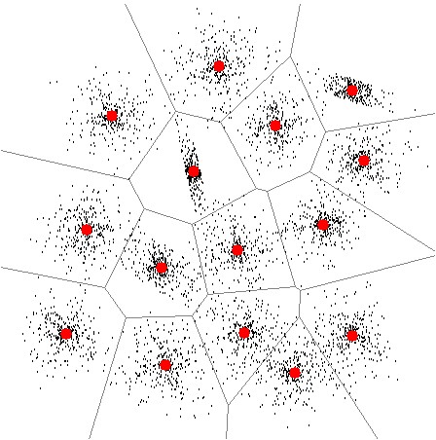
Clustering result as partition
Partition of data
Cluster prototypes
Illustrated by
Convex hulls
Illustrated by
Voronoi diagram

Slide 29
Duality of partition and centroids
Partition of data
Cluster prototypes
Partition by nearest
prototype mapping
Centroids
as prototypes

Slide 30
Dependency of data structures
Centroid condition: for a given partition (P), optimal cluster centroids (C) for minimizing MSE are the average vectors of the clusters:
Optimal partition: for a given centroids (C), optimal partition is the one with nearest centroid :

Slide 31
K-means algorithm

Slide 32
K-means algorithm
X = Data set
C = Cluster centroids
P = Partition
K-Means(X, C) → (C, P)
REPEAT
C_{prev} ← C;
FOR i:=1 TO N DO p_{i} ← FindNearest(x_{i}, C);
FOR j:=1 TO k DO
c_{j} ← Average x_{i} ∀ p_{i} = j;
UNTIL C = C_{prev}
Assignment step
Centroid step

Slide 33
Calculating centroid
Mean in dimension
X
1 2 1 2 2 6 2 1
Calculate sums:
FOR i:=1 TO N DO
j := P[i];
Sum[j] := Sum[j] + X[i];
n[j]++;
Centroids:
FOR j:=1 TO k DO
C[j] := Sum[j] / n[j];
1 2 1 2 6 6 2 2
1 4 1 3 3 7 7 7
1 4 1 1 5 5 5 2
∑ = 4 12 4 8 16 24 16 12
C
1 3 1 2 4 6 4 3
O(N)

Slide 34
Calculating assignments
Find nearest centroid
Data:
Assignments:
FOR i:=1 TO N DO
best := NearestCentroid(I,C);
P[i] := best;
Nearest centroid:
NearestCentroid(x,C)
best:=1; mind:=MAXINT;
FOR j:=1 TO k DO
d := dist(x, C[j]);
IF d < mind THEN
best := j;
mind := d;
RETURN(best);
x₁ x₂ x₃ … x_{n}
n=5,000
Centroids:
C₁ C₂ C₃ … C_{k}
k=15
O(kN)

Slide 35
Mean or median?
1
2
4
8
10
Mean
1
2
4
5
8
10
Median
1
2
4
8
10

Slide 36
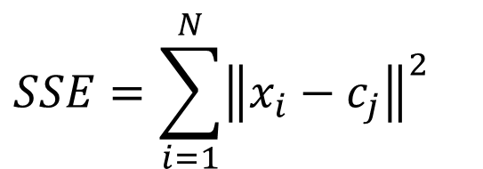
Mean is optimal for SSE
$$SSE=\sum_{i=1}^{N}{{\left\|x_{i}−c_{j}\right\|}^{2}}$$
Mean
1
2
4
5
8
10
SSE = 16 + 9 + 1 + 9 + 25 = 60
Median
1
2
4
8
10
SSE = 9 + 4 + 0 + 16 + 36 = 64

Slide 37
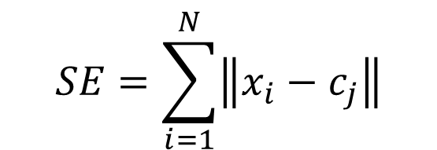
Median is optimal for SE
$$SE=\sum_{i=1}^{N}{\left\|x_{i}−c_{j}\right\|}$$
Mean
1
2
4
5
8
10
SE = 4 + 3 + 1 + 3 + 5 = 16
Median
1
2
4
8
10
SE = 3 + 2 + 0 + 4 + 6 = 15

Slide 38
Multidimensional example
Median
Mean

Slide 39
Summary

Slide 40
How to solve?
Solve the clustering:
  Given input data (X) of N data vectors, and number of clusters (M), find the clusters.
  Result given as a set of prototypes, or partition.
Solve the number of clusters:
  Define appropriate cluster validity function f.
  Repeat the clustering algorithm for several M.
  Select the best result according to f.
Solve the problem efficiently.
Algorithmic problem
Mathematical problem
Computer science problem

Slide 41
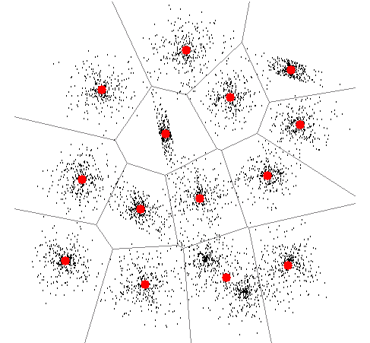
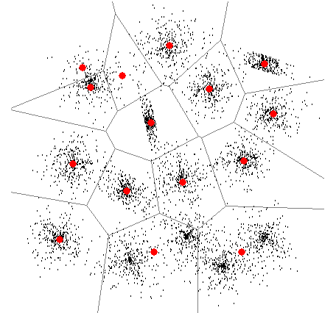
Challenges in clustering
Incorrect cluster allocation
Incorrect number of clusters
Too many clusters
Clusters missing
Cluster missing

Slide 42
Taxonomy of clustering
[Jain, Murty, Flynn, Data clustering: A review, ACM Computing Surveys, 1999.]
One possible classification based on cost function.
MSE is well defined and most popular.

Slide 43
Clustering method
Clustering method = defines the problem
Clustering algorithm = solves the problem
Problem defined as cost function
  Goodness of one cluster
  Similarity vs. distance
  Global vs. local (“merge cost”, “cut”)
Solution: algorithm to solve the problem

Slide 44
Complexity of clustering
Number of possible clusterings:
Clustering problem is NP complete
[Garey et al., 1982]
Optimal solution by branch-and-bound in exponential time.
Practical solutions by heuristic algorithms.

Slide 45
Software

Slide 46
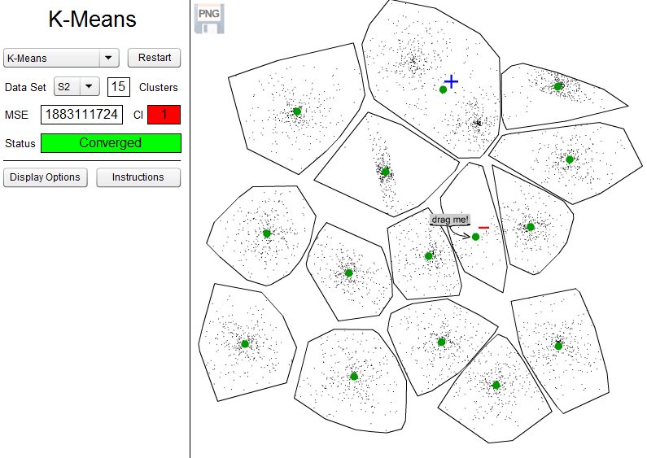
Animator
https://cs.uef.fi/~ashfaq/

Slide 47
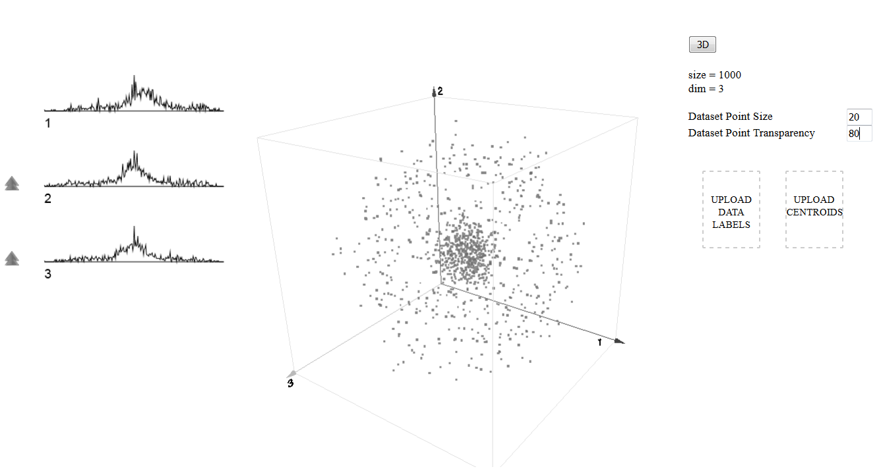
Clusterator
http://cs.uef.fi/paikka/Radu/clusterator/

Slide 48
Other software

Slide 49
Conclusions
Clustering is a fundamental tool needed everywhere in data mining and machine learning.
Failing to do clustering properly may defect the application analysis.
Good clustering tool needed so that practitioners can focus on their application requirements.

Slide 50
Literature
S. Theodoridis and K. Koutroumbas, Pattern Recognition, Academic Press, 3rd edition, 2006.
C. Bishop, Pattern Recognition and Machine Learning, Springer, 2006.
A.K. Jain, M.N. Murty and P.J. Flynn, Data clustering: A review, ACM Computing Surveys, 31(3): 264-323, September 1999.
M.R. Garey, D.S. Johnson and H.S. Witsenhausen, The complexity of the generalized Lloyd-Max problem, IEEE Transactions on Information Theory, 28(2): 255-256, March 1982.
F. Aurenhammer: Voronoi diagrams-a survey of a fundamental geometric data structure, ACM Computing Surveys, 23 (3), 345-405, September 1991.

