Slide 1
Matching Similarity for Keyword-based Clustering
Mohammad Rezaei, Pasi Fränti
rezaei@cs.uef.fi
Speech and Image Processing Unit
University of Eastern Finland
August 2014

Slide 2
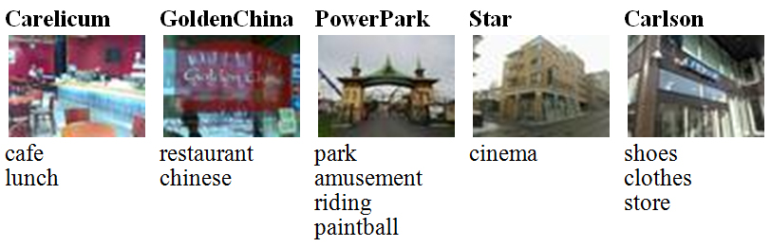
Keyword-Based Clustering
An object such as a text document, website, movie and service can be described by a set of keywords
Objects with different number of keywords
The goal is clustering objects based on semantic similarity of their keywords

Slide 3
Similarity Between Word Groups
How to define similarity between objects as main requirement for clustering?
Assuming we have similarity between two words, the task is defining similarity between word groups

Slide 4
Similarity of Words
Lexical
  Car ≠ Automobile
Semantic
  Corpus-based
  Knowledge-based
  Hybrid of Corpus-based and Knowledge-based
  Search engine based

Slide 5
Wu & Palmer
animal
fish
12
mammal
reptile
amphibian
13
wolf
horse
dog
cat
14
mare
stallion
hunting dog
dachshund
terrier

Slide 6
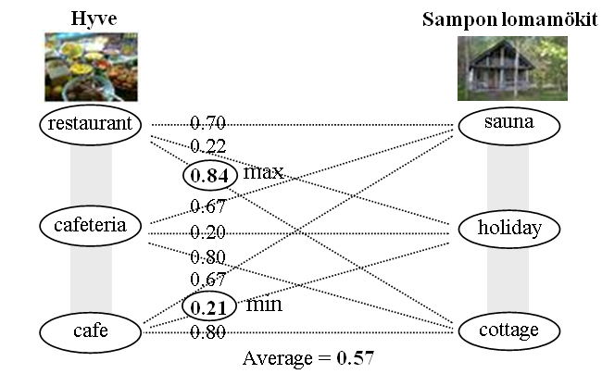
Similarity Between Word Groups
Minimum: two least similar words
Maximum: two most similar words
Average: Summing up all pairwise similarities and calculating average value
We have used Wu & Pulmer measure for similarity of two words

Slide 7
Issues of Traditional Measures
100% similar services:
Min: 0.32
Max: 1.00
Average: 0.66
1- Café, lunch
2- Café, lunch
So, is maximum measure is good?

Slide 8
Issues of Traditional Measures
Different services:
1- Book, store
2- Cloth, store
Max: 1.00
These services are considered exactly similar with maximum measure.

Slide 9
Issues of Traditional Measures
Two very similar services:
1- Restaurant, lunch, pizza, kebab, café, drive-in
2- Restaurant, lunch, pizza, kebab, café
Min: 0.03 (between drive-in and pizza)

Slide 10
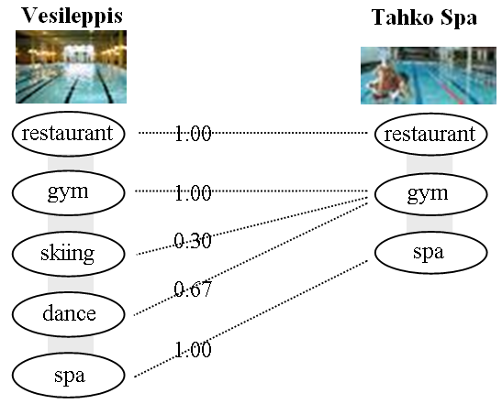
Matching Similarity
Greedy pairing of words
- two most similar words are paired iteratively
- the remaining non-paired keywords are just matched to their most similar words

Slide 11
Matching Similarity
Similarity between two objects with N₁ and N₂ words where N₁ ≥ N₂:
S(w_{i}, w_{p}(i)) is the similarity between word w_{i} and its pair w_{p}(i).

Slide 12
Examples
1- Café, lunch
2- Café, lunch
1.00
1.00
1.00
1- Book, store
2- Cloth, store
0.75
1.00
0.87
1- Restaurant, lunch, pizza, kebab, café, drive-in
2- Restaurant, lunch, pizza, kebab, café
1.00
0.67
1.00
1.00
1.00
1.00
0.94

Slide 13
Experiments
Data
  Location-based services from Mopsi
  (http://www.uef.fi/mopsi)
  English and Finnish words: Finnish words were converted to English using Microsoft Bing Translator, but manual refinement was done to eliminate automatic translation issues
  378 services
Similarity measures:
  Minimum, Average and Matching
Clustering algorithms
  Complete-link and average-link

Slide 14
Similarity between services
Mopsi service | A1- Parturi-kampaamo Nona | A2- Parturi-kampaamo Platina | A3- Parturi-kampaamo Koivunoro | B1- Kielo | B2- Kahvila Pikantti
Keywords | barber hair salon | barber hair salon | barber hair salon shop | cafe cafeteria coffe lunch | lunch restaurant

Slide 15
Similarity between services
Services | A1 | A2 | A3 | B1 | B2
 | Minimum similarity
A1 | - | 0.42 | 0.42 | 0.30 | 0.30
A2 | 0.42 | - | 0.42 | 0.30 | 0.30
A3 | 0.42 | 0.42 | - | 0.30 | 0.30
B1 | 0.30 | 0.30 | 0.30 | - | 0.32
B2 | 0.30 | 0.30 | 0.30 | 0.32 | -
 | Average similarity
A1 | - | 0.67 | 0.67 | 0.47 | 0.51
A2 | 0.67 | - | 0.67 | 0.47 | 0.51
A3 | 0.67 | 0.67 | - | 0.48 | 0.51
B1 | 0.47 | 0.47 | 0.48 | - | 0.63
B2 | 0.51 | 0.51 | 0.51 | 0.63 | -
 | Matching similarity
A1 | - | 1.00 | 0.99 | 0.57 | 0.56
A2 | 1.00 | - | 0.99 | 0.57 | 0.56
A3 | 0.99 | 0.99 | - | 0.55 | 0.56
B1 | 0.57 | 0.57 | 0.55 | - | 0.90
B2 | 0.56 | 0.56 | 0.56 | 0.90 | -

Slide 16
Evaluation Based on SC Criteria
Run clustering for different number of clusters from K=378 to 1
Calculate SC criteria for every resulted clustering
The minimum SC, represents the best number of clusters

Slide 17
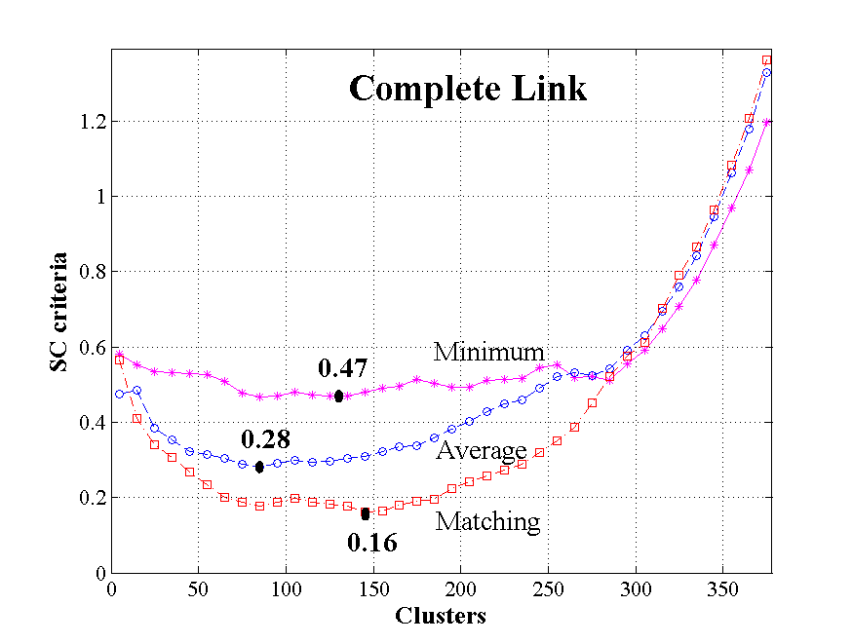
SC – Complete Link

Slide 18
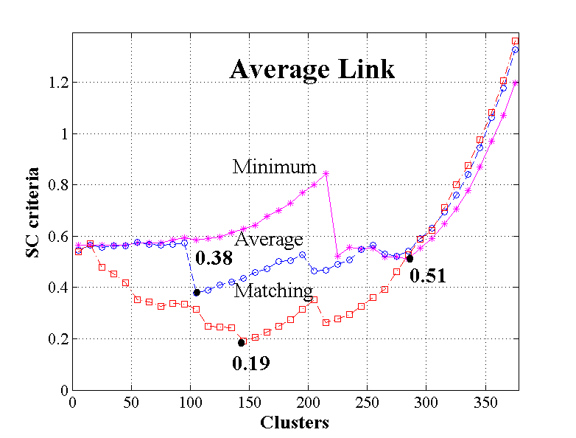
SC – Average Link

Slide 19
The sizes of the four largest clusters
Complete link
Similarity: | Sizes of 4 biggest clusters
Minimum | 106 | 88 | 18 | 18
Average | 44 | 22 | 20 | 19
Matching | 27 | 23 | 19 | 17
Average link
Similarity: | Sizes of 4 biggest clusters
Minimum | 22 | 12 | 10 | 8
Average | 128 | 41 | 34 | 17
Matching | 27 | 23 | 17 | 17

Slide 20
Conclusion and Future Work
A new measure called matching similarity was proposed for comparing two groups of words.
Future work
  Generalize matching similarity to other clustering algorithms such as k-means and k-medoids
  Theoretical analysis of similarity measures for word groups

